Slide 1

Inverse Design of Non-Periodic Dual-Pillar Structures for Dielectric Laser Acceleration
Master’s Thesis in Physics Presentation
Christian Neureuter

Slide 2


What I thought doing this project would be like:
What it was actually like:

Slide 3
Special Thanks

Slide 4
Outline
01
Introduction
06
Results
02
DLA Theory
07
Issues with the Adjoint Method
03
Adjoint Method and Inverse Design
08
How to Fix the Adjoint Method for Our System
04
Numerical Optimization
09
Future Considerations
05
Algorithm Description

Slide 5
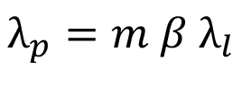
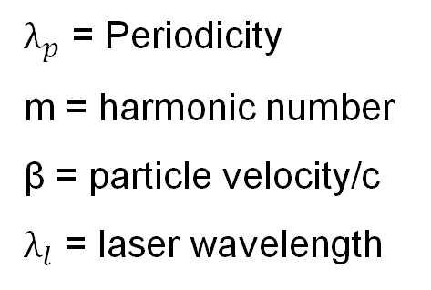
Introduction
Synchronicity condition between the particle trajectory and driving laser field.
$$λ_{p}=m β λ_{l}$$
$λ_{p}$ = Periodicity
m = harmonic number
β = particle velocity/c
$λ_{l}$ = laser wavelength
Notes:
Test note

Slide 6
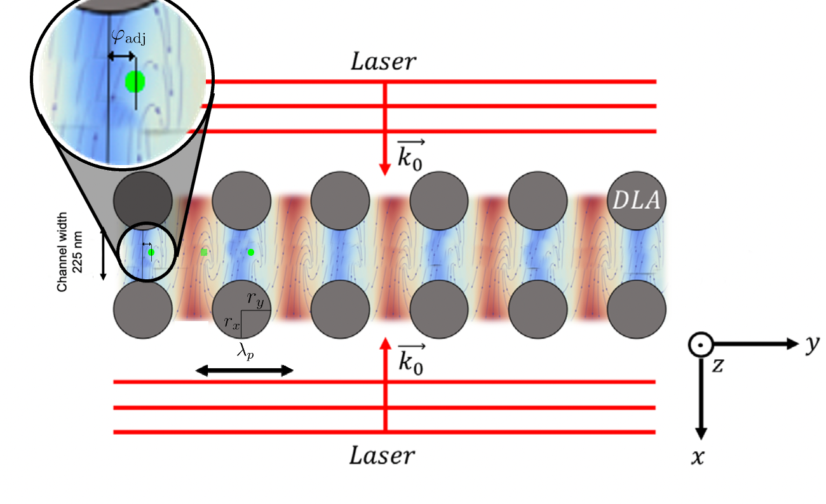
Introduction
Coordinate and Variable Definitions
Notes:
Test note

Slide 7
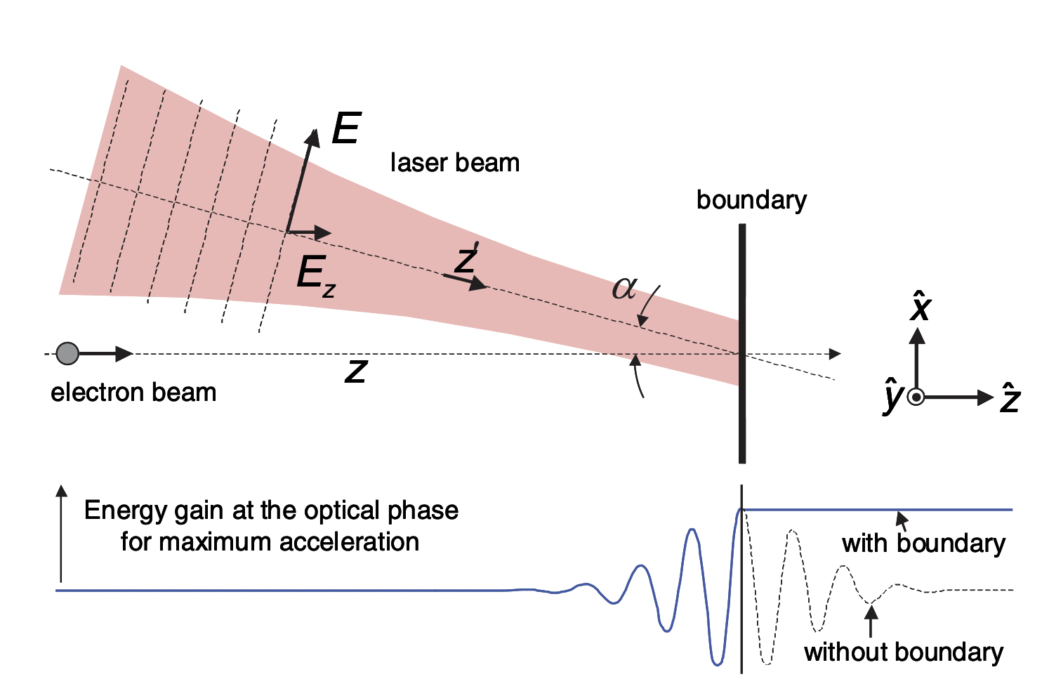
DLA Theory
Lawson-Woodward Theorem and ‘near-field’ acceleration
Notes:
Test note

Slide 8
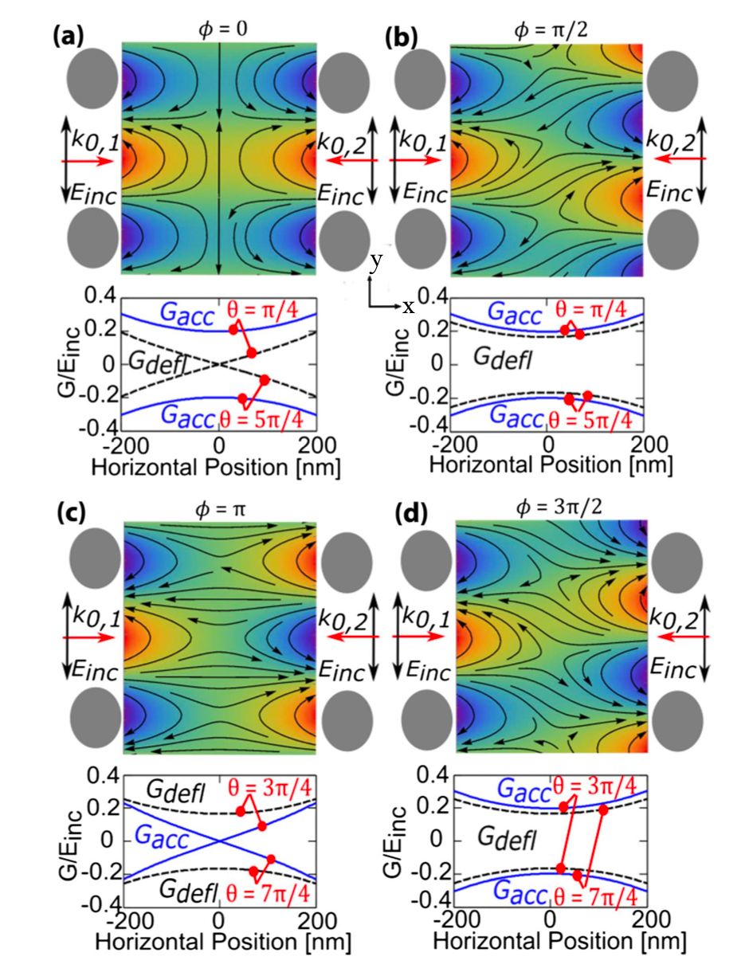
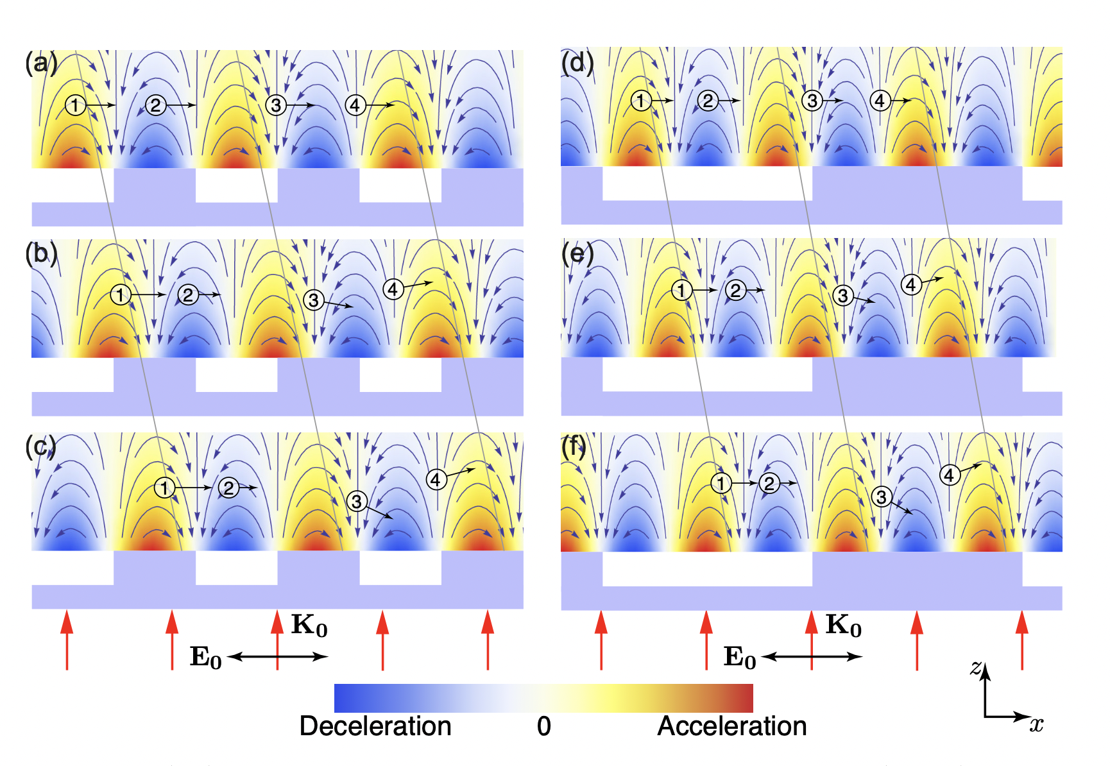
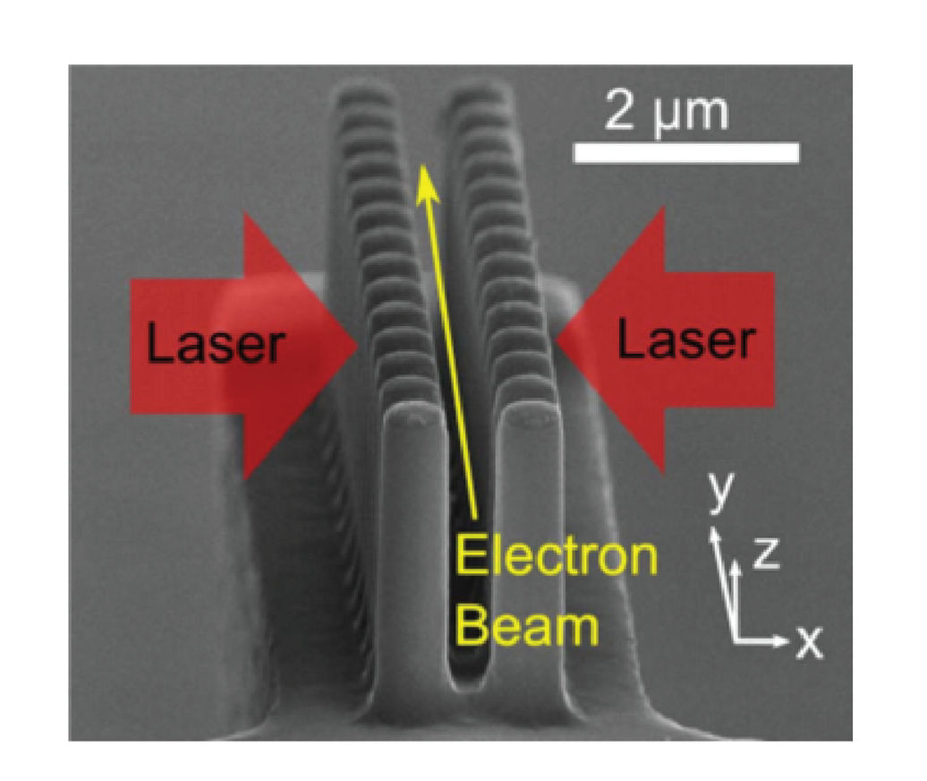
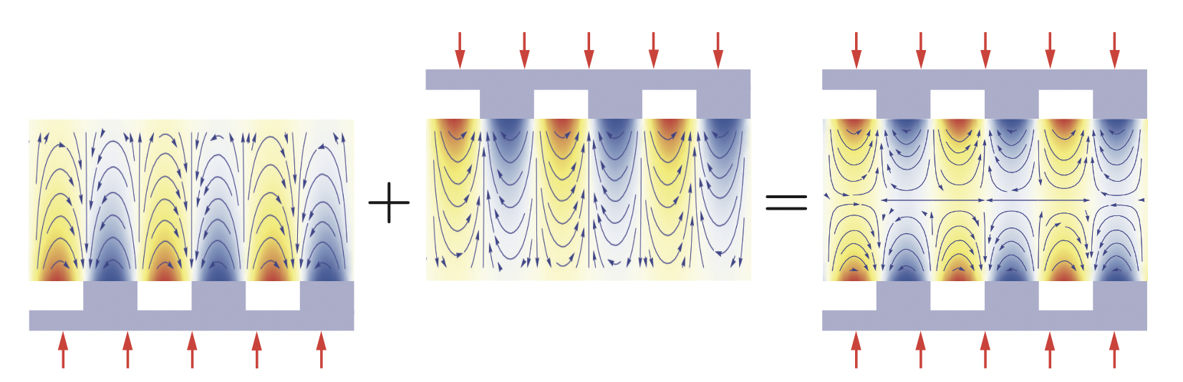
DLA Theory
Dual Drive, Dual Grating Structures
Notes:
Test note

Slide 9
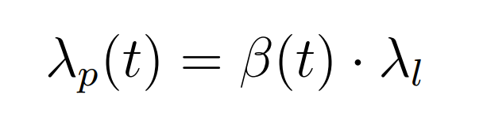
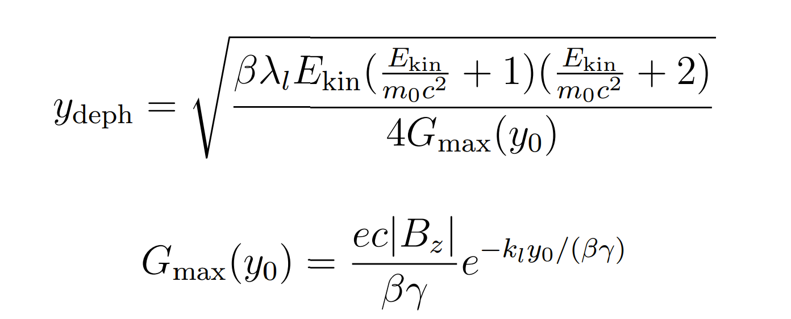
DLA Theory
Non-Periodic Structures
Notes:
Test note

Slide 10
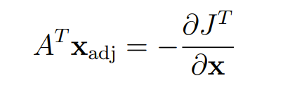
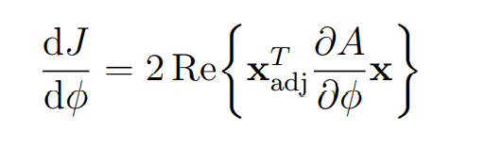
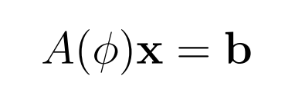
Adjoint Method and Inverse Design
Generalized Adjoint Method
Notes:
Test note

Slide 11
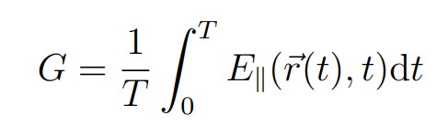
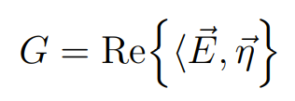
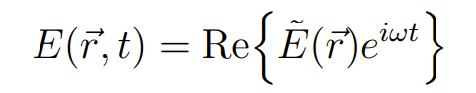
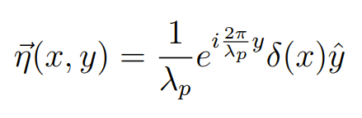
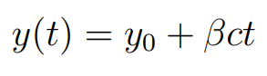
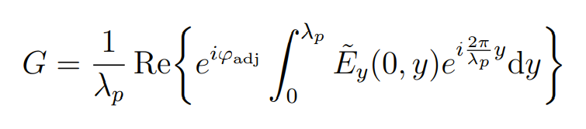
Adjoint Method and Inverse Design
Adjoint Method for DLA
Notes:
Test note

Slide 12
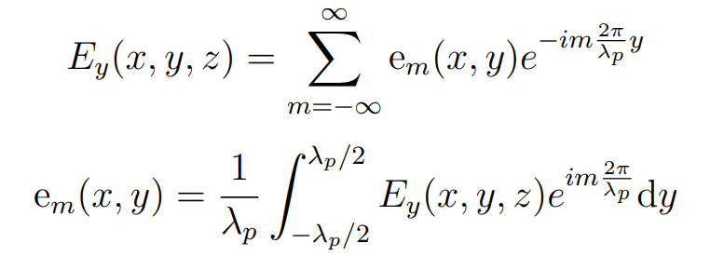
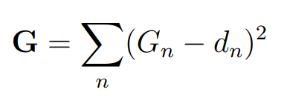
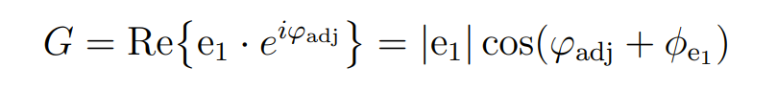
Adjoint Method and Inverse Design
Cost Function
Notes:
Test note

Slide 13
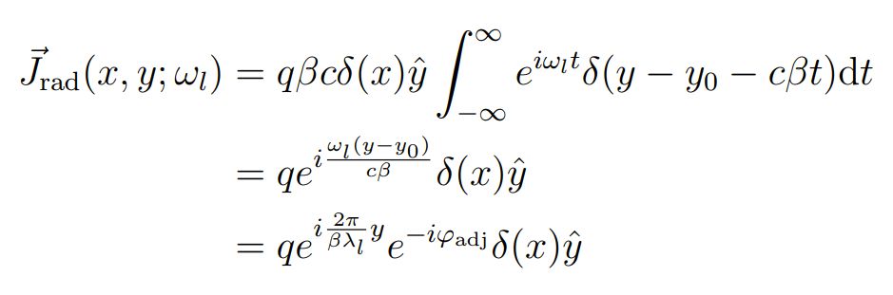
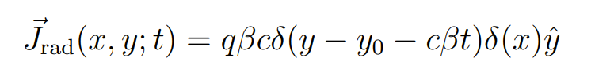
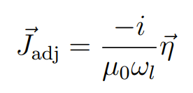
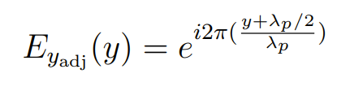
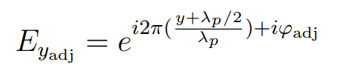
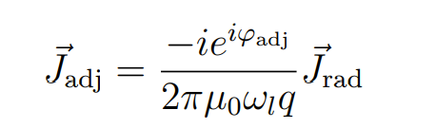
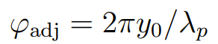
Adjoint Method and Inverse Design
Adjoint Source and Adjoint Phase
Notes:
Test note

Slide 14
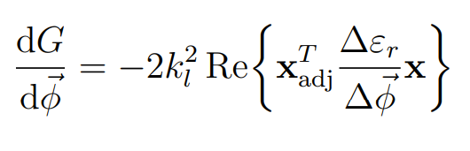
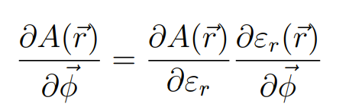
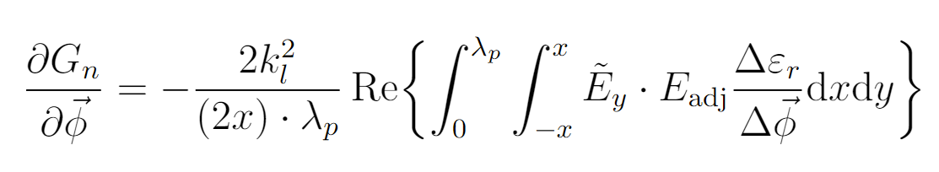
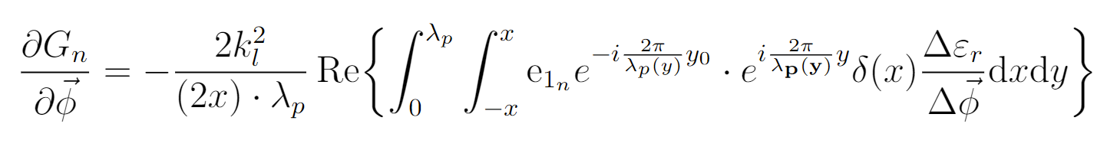
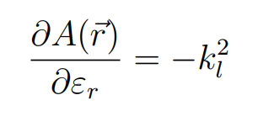
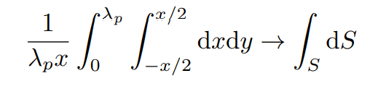
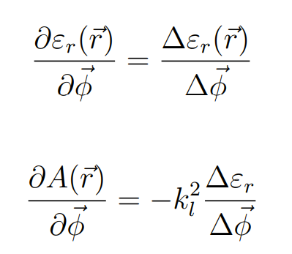
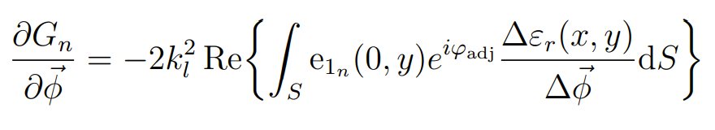
Adjoint Method and Inverse Design
Adjoint Inverse Design
Notes:
Test note

Slide 15
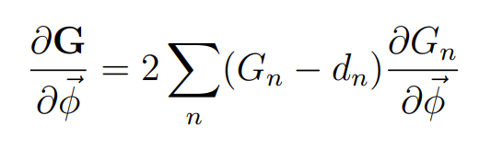
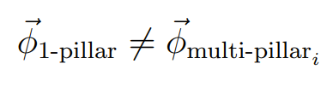
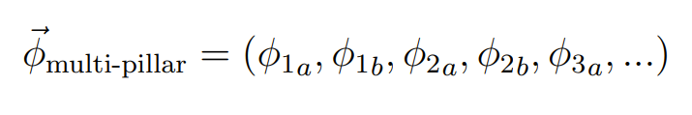
Adjoint Method and Inverse Design
Adjoint Inverse Design
Notes:
Test note

Slide 16
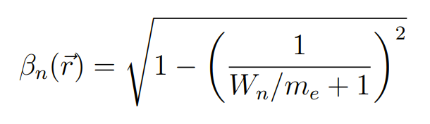
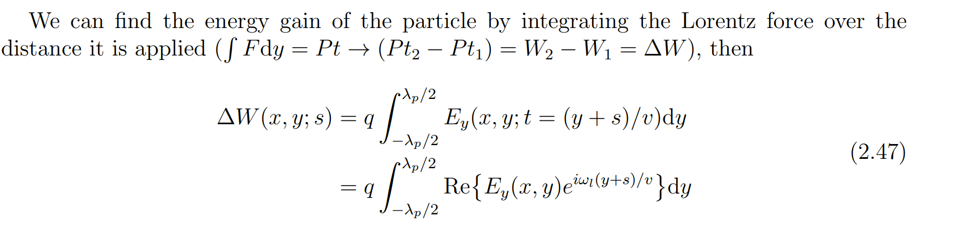
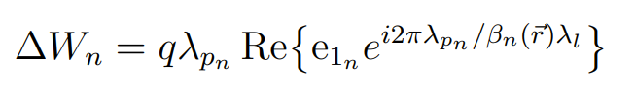
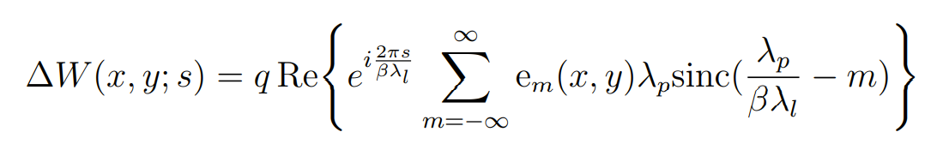
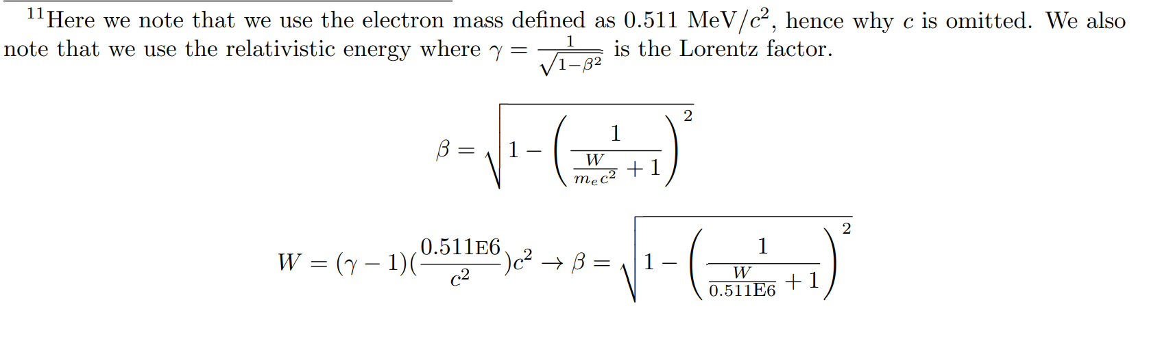
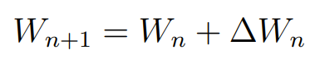
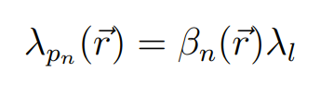
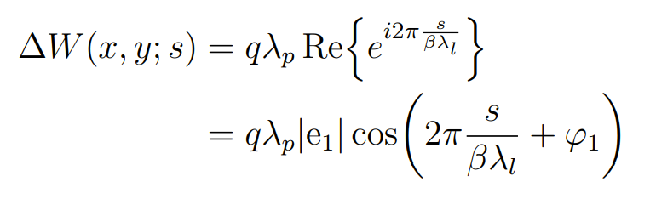
Adjoint Method and Inverse Design
Non-Periodicity in the Adjoint Method
Notes:
Test note

Slide 17
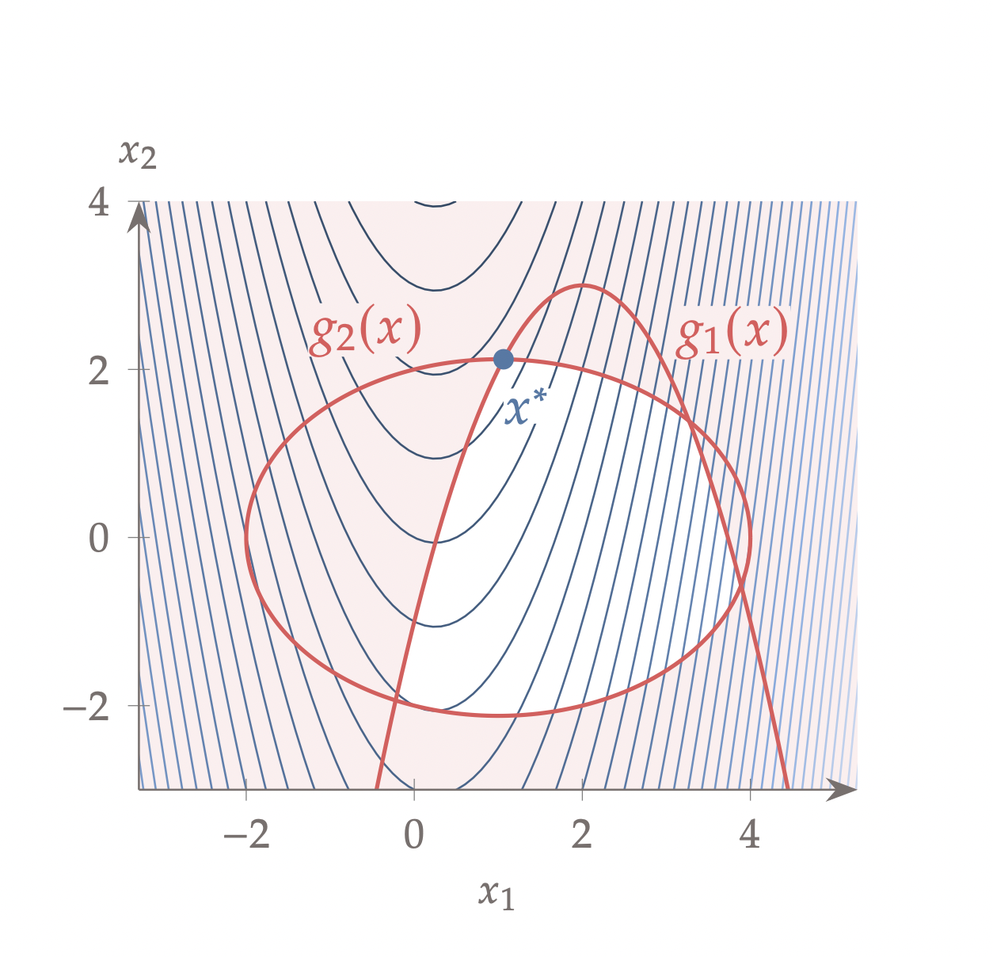
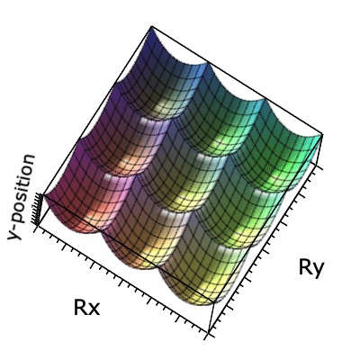



Numerical Optimization
Gradient Descent, Constrained Optimization, and Non-Convex Parameter Spaces
Notes:
Test note

Slide 18




Inverse Design Algorithm
Notes:
Test note

Slide 19








Inverse Design Algorithm
Notes:
Test note

Slide 20




Results
Notes:
Test note

Slide 21










Results
Notes:
Test note

Slide 22








Results
Notes:
Test note

Slide 23




Issues with the Adjoint Method
Asymmetry and Non-Periodicity
Notes:
Test note

Slide 24


Possible Solutions to Adjoint Inverse Design
Asymmetry and Non-Periodicity
Notes:
Test note

Slide 25
Possible Solutions to Adjoint Inverse Design
Calculate ∆ℇ as before
Weight the rx, ry, and y-pos
Apply the Gaussian/Inverse Square filter to ∆ℇ/∆𝜑, where each column corresponds to a period
Sum of each column multiplied by forward and adjoint fields, then integrated over the area yields a more accurate gradient calculation
Constraints and bounds can be applied during the construction of ∆ℇ, as before
Notes:
Test note

Slide 26
Conclusions and Future Considerations
Notes:
Test note

Slide 27


References
Notes:
Test note

Slide 28



References
Notes:
Test note

Slide 29
Thank you for your time

